Slide 1

By Laura Mandell

Slide 2
Scalar
Using Scalar (@anvscalar; http://scalar.usc.edu) to publish, publicly or privately, your work, collaborative or individual
About: The Scalar publishing platform provides extensive multi-media annotation and analysis tools that can be used in authoring an article, book, exhibit, etc., either singly or in groups. It is produced by the Mellon-funded Alliance for Networking Visual Culture.

Slide 3
Online Written Guides (written in Scalar):
Quick Start: http://scalar.usc.edu/works/guide/quickstarts
Full User’s Guide: http://scalar.usc.edu/works/guide/getting-started
Free Online Webinars: http://scalar.usc.edu/webinars/registration/

Slide 4
What Scalar Can Do:
Example: http://scalar.usc.edu/works/complex-television/index

Slide 5
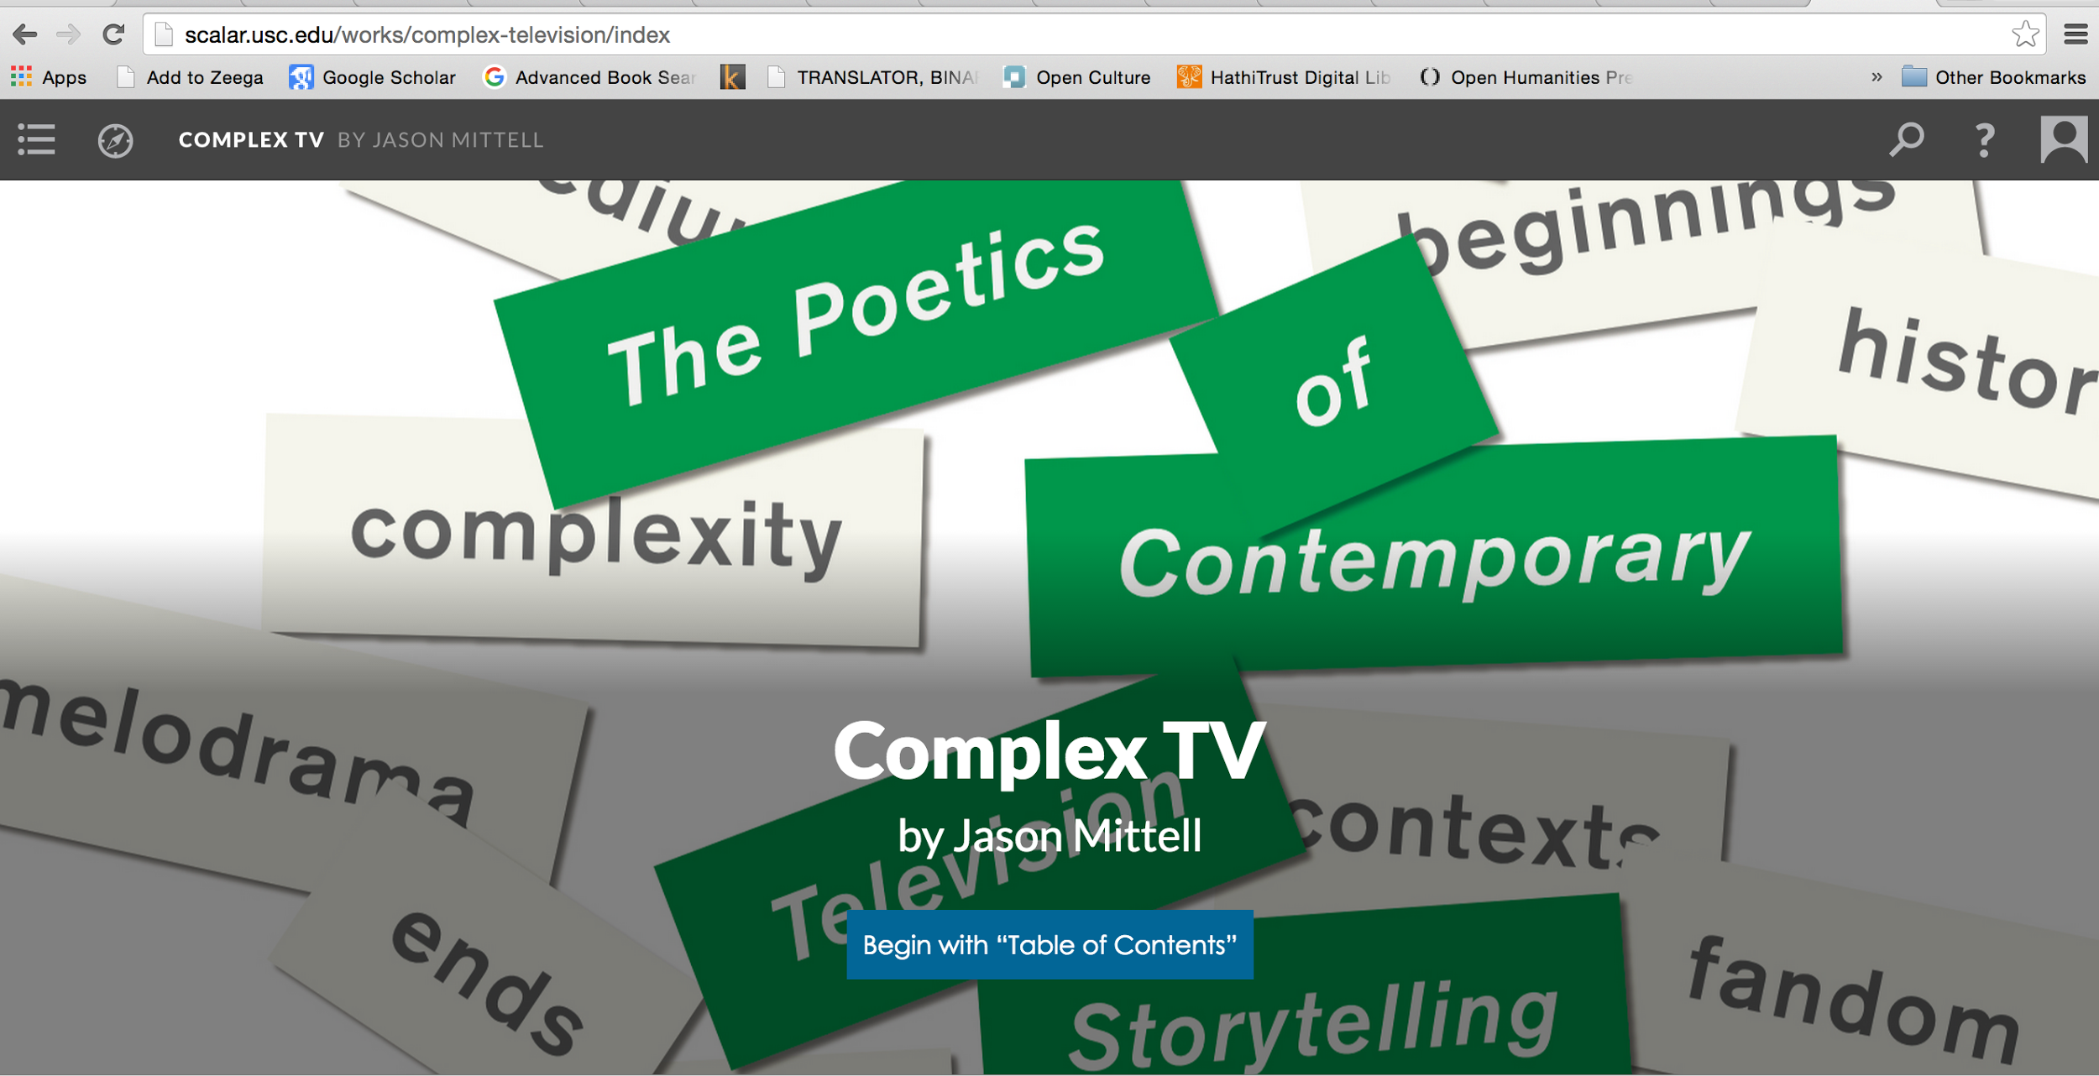
Notes:
Complex TV is a previously published book that was added into the Scalar Platform.

Slide 6
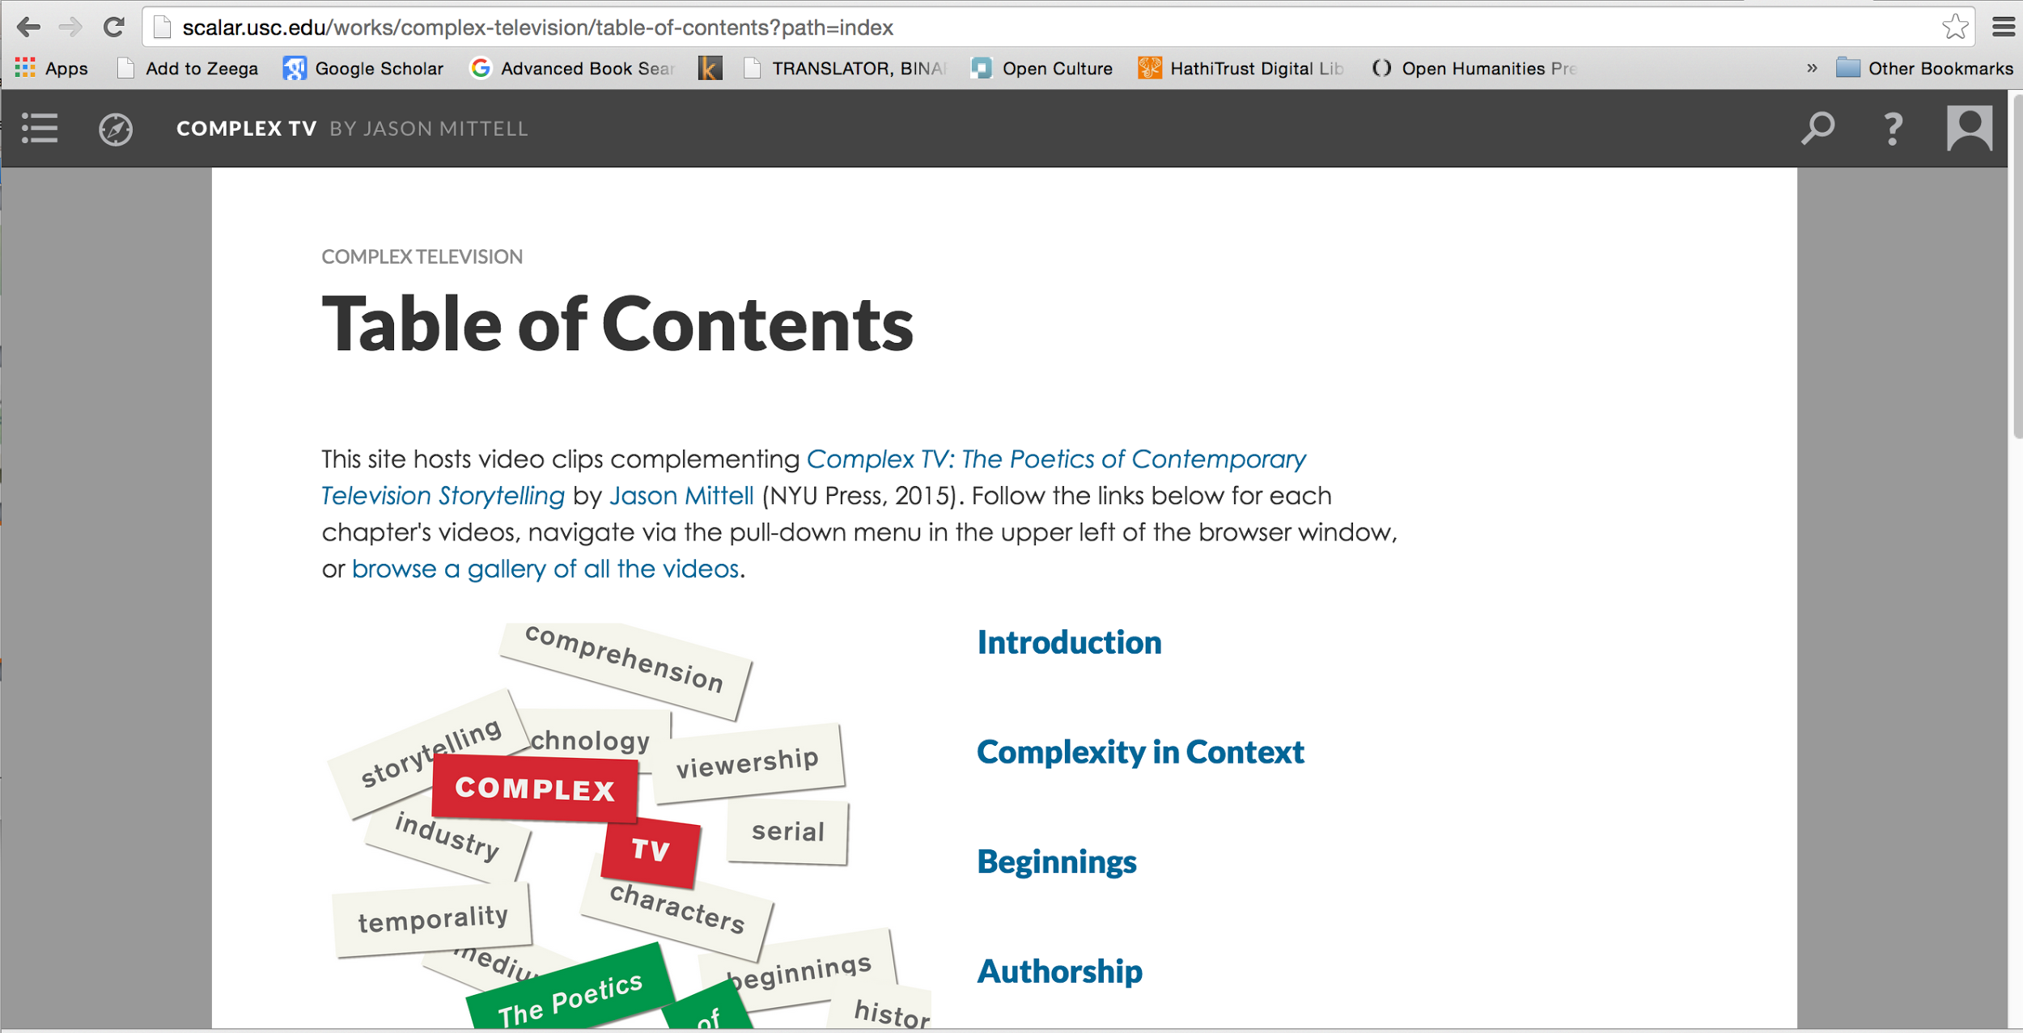
Notes:
It has a standard table of contents, resembling the print one.

Slide 7
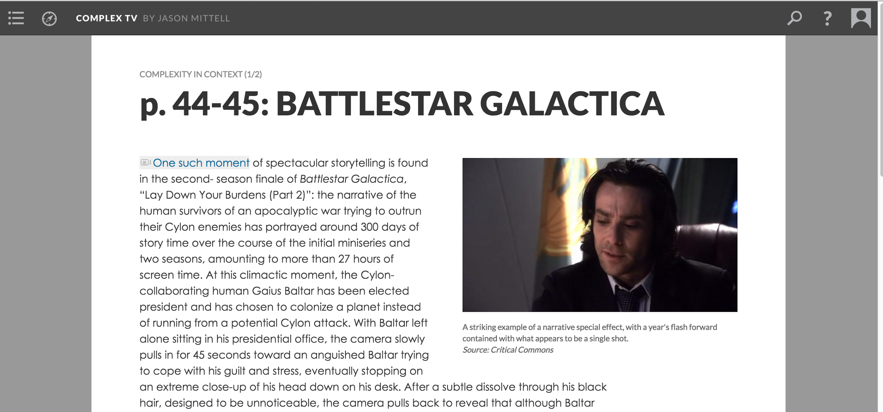
Notes:
And you can see page numbers of the printed book indicated at the top.

Slide 8
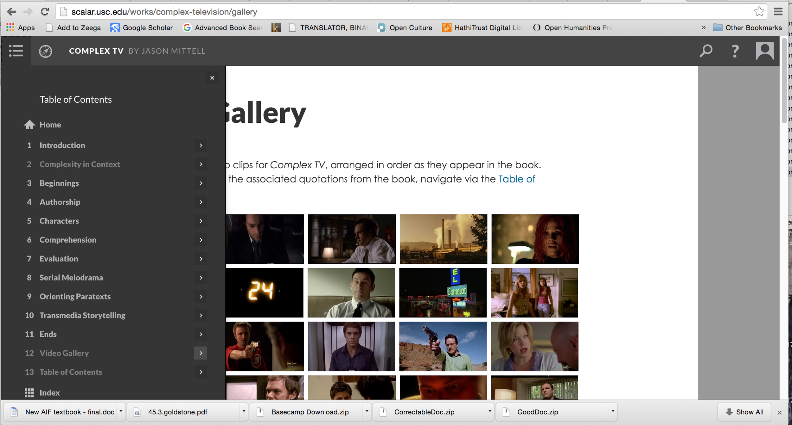
Notes:
But there is also a video gallery where you can see the snippets of TV shows referred to in each chapter.

Slide 9
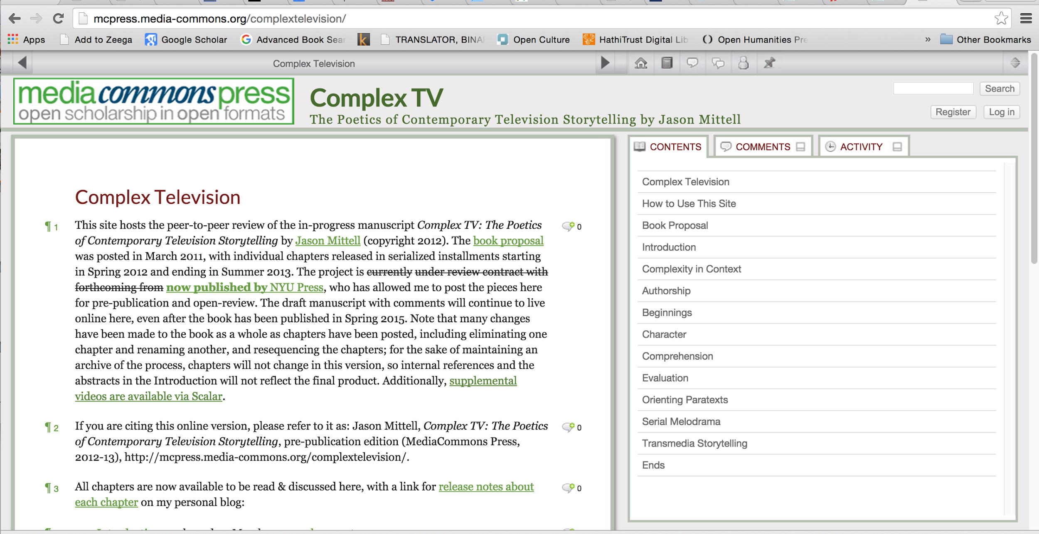
Notes:
Complex Television has also been published in Media Commons Press.

Slide 10
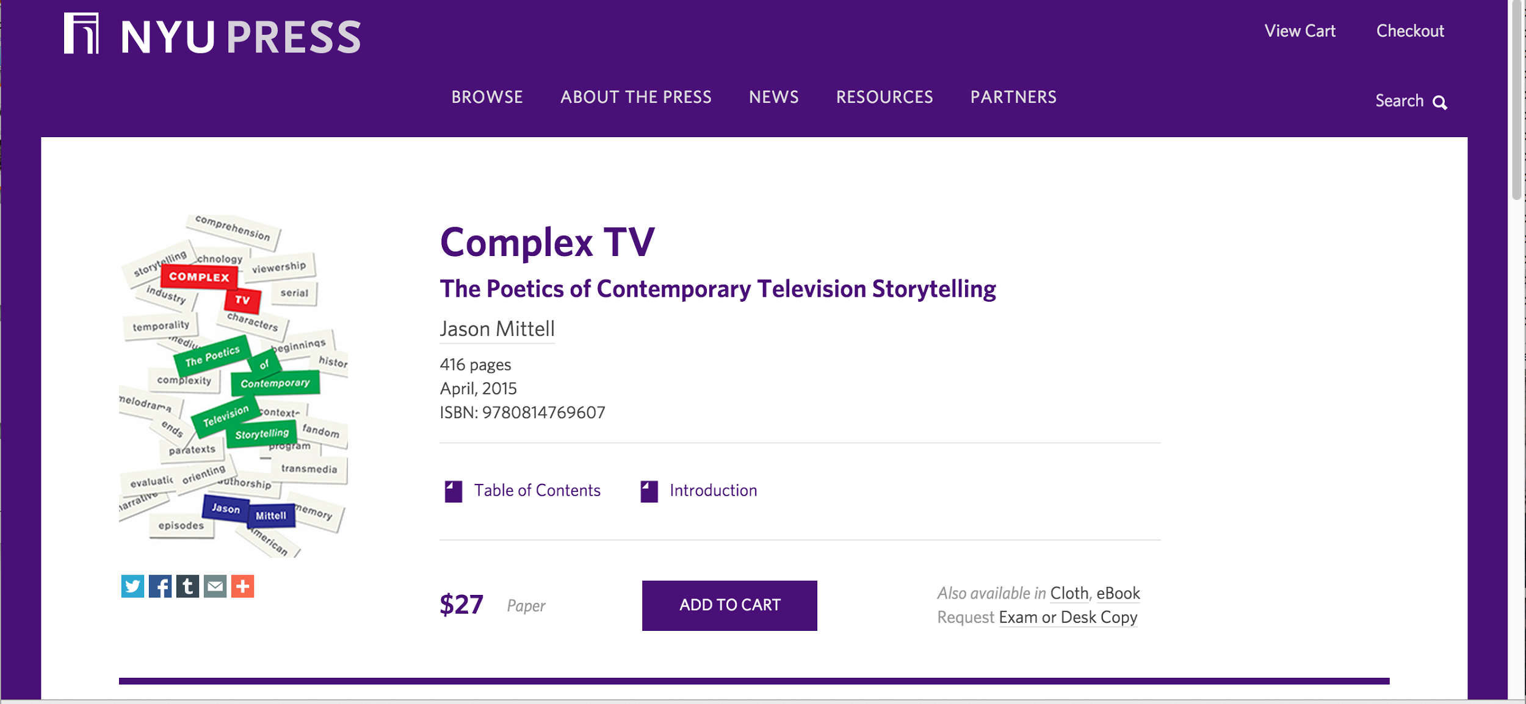
Notes:
And in print by NYU Press.

Slide 11
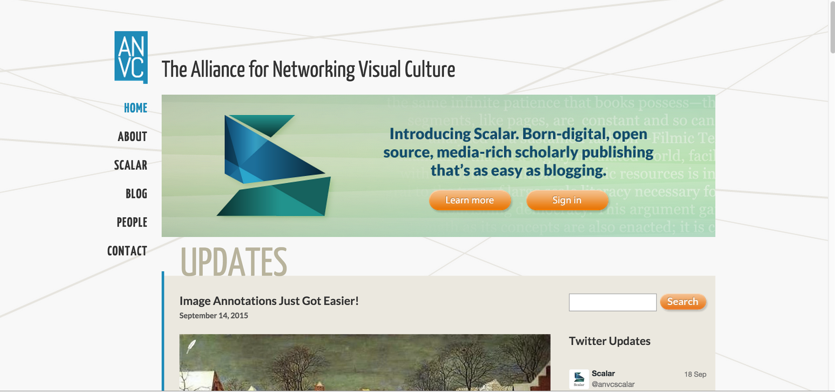
Notes:
Go to Scalar and “Sign In.’

Slide 12
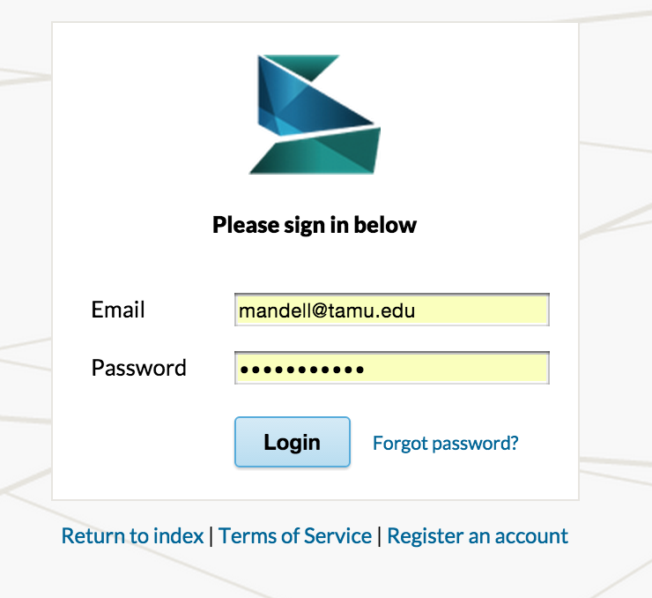
Notes:
You can register an account from this page if you do not already have one.

Slide 13
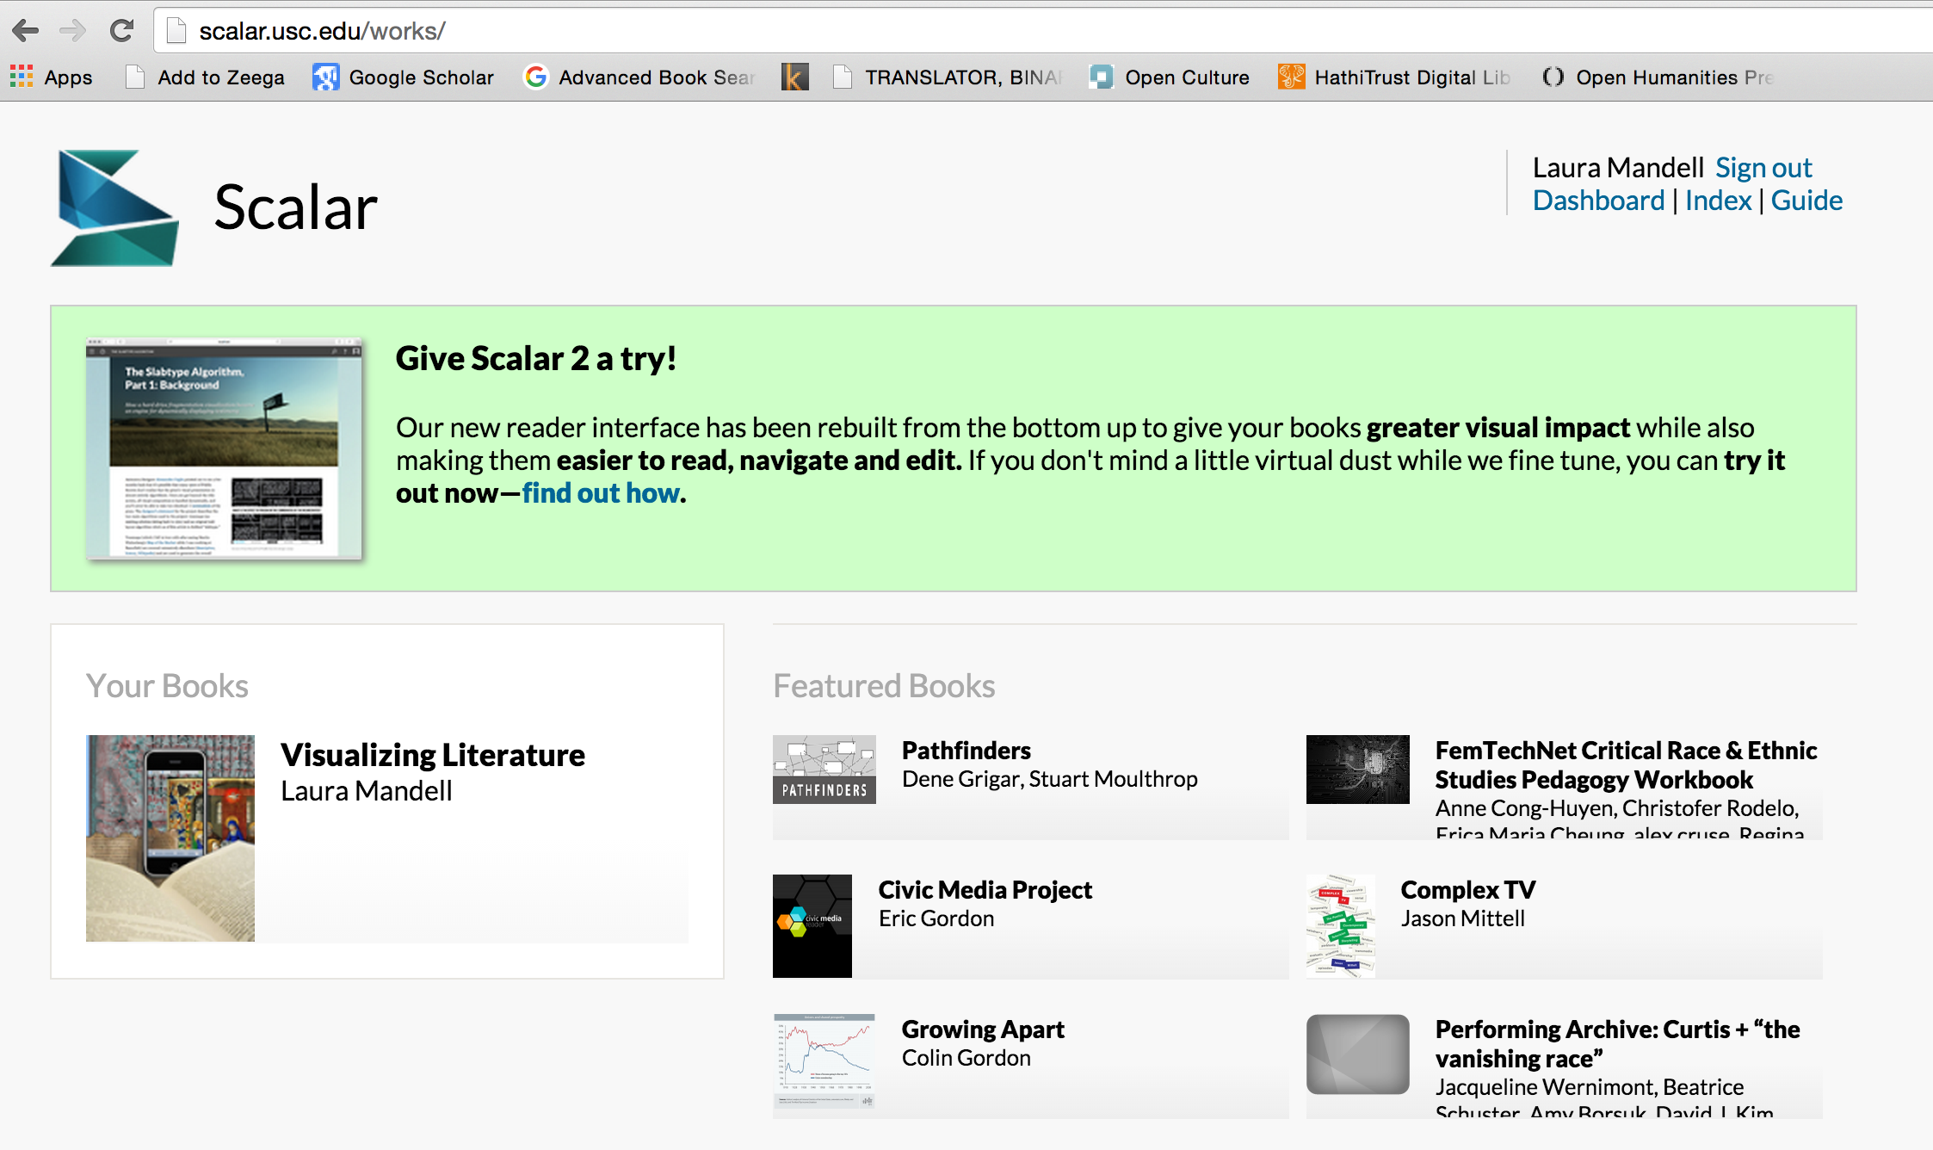
Notes:
I have started a book, “Visualizing Literature,” that I wish to write with students.

Slide 14
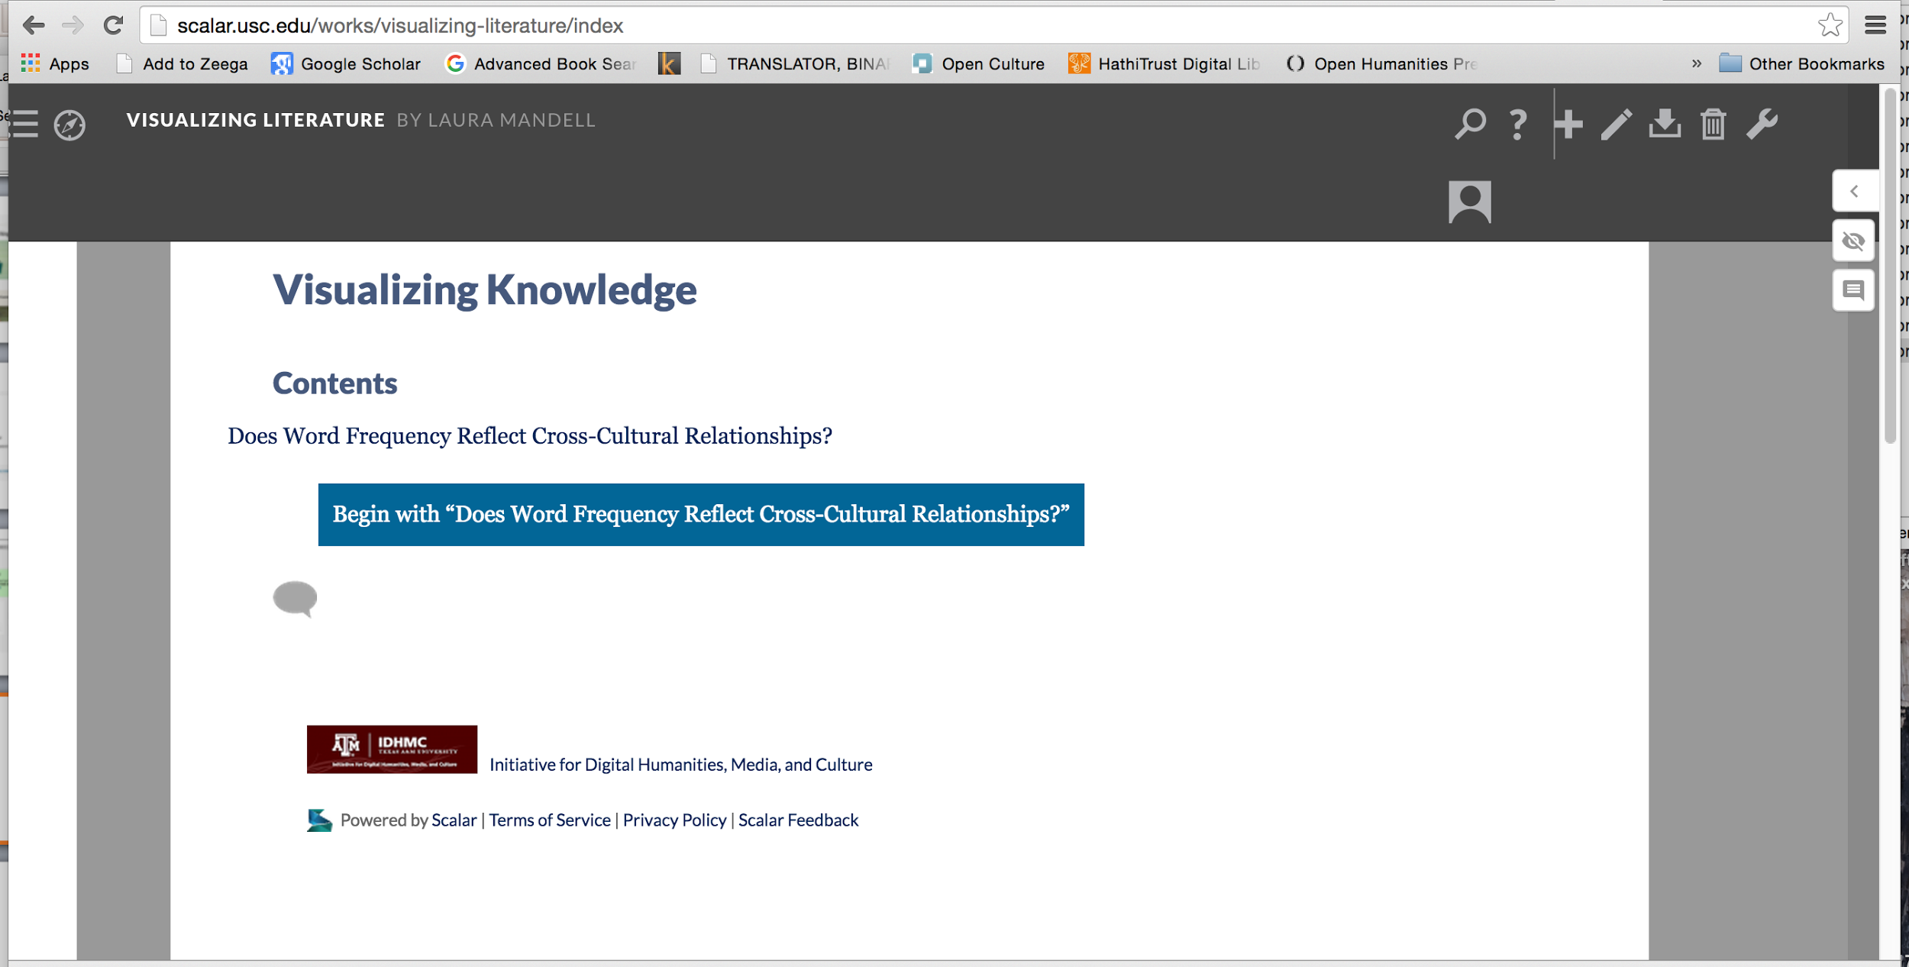
Notes:
Students posted a video they made in the book.

Slide 15
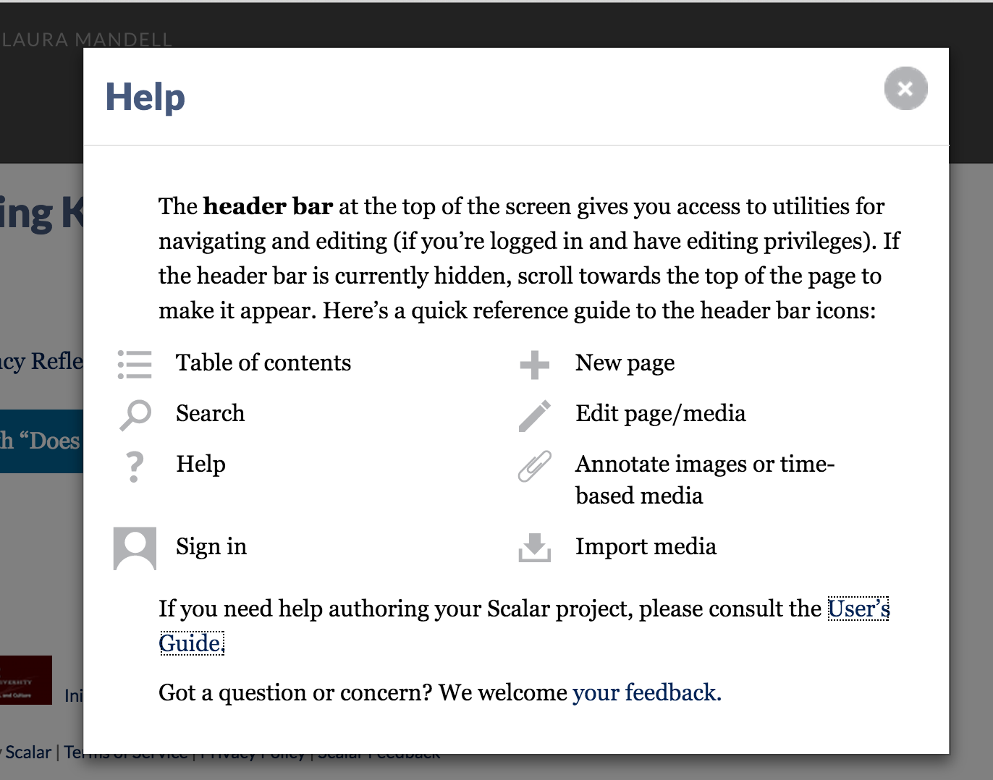
Notes:
The help button describes all the icons you see on your header bar.

Slide 16
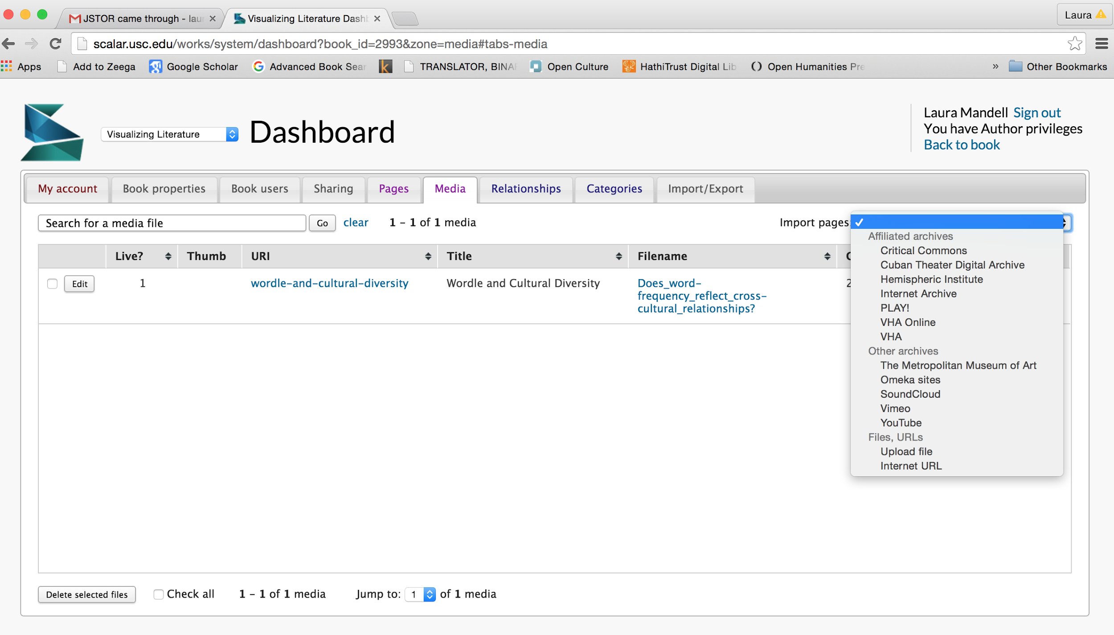
Notes:
The Dashboard allows you to set up book users (including co-authors), to create pages and import media, and more. Here on the Media Tab I can import films and videos from many sources, including Critical Commons. Once it is imported, I can insert it into a page and annotate it so that the annotations play as the video plays. Scalar Webnars help you understand all its capacities.

